Slide 1
Pine Valley Furniture.

Slide 2
Systems Analysis and Design
University of Phoenix
Manuel Torres
Anthony Barrett
11/30/20

Slide 3
Systems Analysis and Design
Systems scrutiny and design, as done by systems experts, seeks to comprehend what people require to study data input.
Additionally, systems analysis and design are cast-off to analyze, design, and implement enhancements.
System Installation without appropriate planning contributes to countless operator disappointment and regularly causes the system to tumble into neglect.
Systems analysis and project lends structure to the analysis and design of information systems.
Notes:
Systems scrutiny and design, as done by systems experts, seeks to comprehend what people require to study data input, store data, and output information in the setting of a specific enterprise. By doing a detailed analysis, experts pursue to find and answer the right tasks. Additionally, systems analysis and design are cast-off to analyze, design, and implement enhancements with the assistance of operators and the effectiveness of businesses that can be done with the use of computerized information systems.
System Installation without appropriate planning contributes to countless operator disappointment and regularly causes the system to tumble into neglect. Systems analysis and project lends structure to the analysis and design of information systems, an expensive attempt that may then have been done in a random way.

Slide 4
Systems Analysis and Design
Systems analysis and design include working with present and ultimate users of information systems.
Operator participation through the systems project is sensitive to the fruitful growth of computerized information systems.
Users are stirring to the front as software development sides become extra internationally in their arrangement.
Notes:
It can be believed of as a sequence of procedures systematically assumed to improve a business over the use of electronic information systems. Systems analysis and design include working with present and ultimate users of information systems to help them in working with skills in a business setting.
Operator participation through the systems project is sensitive to the fruitful growth of computerized information systems. Users are stirring to the front as software development sides become extra internationally in their arrangement. This explains that there is more importance on working with software users; on execution analysis of their corporate, difficulties, and aims; and on collaborating the analysis and design of the strategic system to all involved.

Slide 5
4 phases of the project management life cycle
The project management life sequence is typically broken down into four stages:
Initiation
Planning
Execution
Closure
Notes:
1. Initiation
Initially, you need to recognize a commercial need, problem, or opportunity. In this stage, you figure out a goal for the project, decide whether the development is viable, and recognize the main deliverables for the project.
Steps for the project initiation phase may include the following:
➢ Undertaking a viability study: Find the main problem the project will solve and whether the project will bring a resolution to that problem
➢ Finding scope: Describe the depth and breadth of the plan
➢ Identifying deliverables: Define the product to provide
➢ Identifying project shareholders: Find out who the project impacts and what their needs might be
➢ Developing a business situation: Use the above principles to make a comparison of the possible costs and assistances for the project to regulate if it is viable
➢ Developing a statement of work: Document the project’s purposes, possibilities, and deliverables that the expert has identified before as a working contract between the project owner and those working on the project.
2. Planning
After the project is accepted to move on the planning phase is the next stage.
Steps for the project planning phase may include the following:
Creating a project plan: Identify the project timeline, including the phases of the project, the tasks to be performed, and possible constraints
Creating workflow diagrams: Visualize your processes using swim lanes to make sure team members clearly understand their role in a project
Estimating budget and creating a financial plan: Use cost estimates to determine how much to spend on the project to get the maximum return on investment
Gathering resources: Build your functional team from internal and external talent pools while making sure everyone has the necessary tools (software, hardware, etc.) to complete their tasks
Anticipating risks and potential quality roadblocks: Identify issues that may cause your project to stall while planning to mitigate those risks and maintain the project’s quality and timeline
Holding a project kickoff meeting: Bring your team on board and outline the project so they can quickly get to work
3. Execution
The execution phase turns your plan into action. The project manager's job in this phase of the project management life cycle is to keep work on a track, organize team members, manage timelines, and make sure the work is done according to the original plan.
Steps for the project execution phase may include the following:
Creating tasks and organizing workflows: Assign granular aspects of the projects to the appropriate team members, making sure team members are not overworked
Briefing team members on tasks: Explain tasks to team members, providing necessary guidance on how they should be completed, and organizing process-related training if necessary
Communicating with team members, clients, and upper management: Provide updates to project stakeholders at all levels
Monitoring quality of work: Ensure that team members are meeting their time and quality goals for tasks
Managing budget: Monitor spending and keeping the project on track in terms of assets and resources
If you have a properly documented process already in place, executing the project will be much easier.
Closure
Once your team has completed work on a project, you enter the closure phase. In the closure phase, you provide final deliverables, release project resources, and determine the success of the project.
Steps for the project closure phase may include the following:
Analyzing project performance: Determine whether the project's goals were met (tasks completed, on time, and on a budget) and the initial problem solved using a prepared checklist.
Analyzing team performance: Evaluate how team members performed, including whether they met their goals along with timeliness and quality of work
Documenting project closure: Make sure that all aspects of the project are completed with no loose ends remaining and providing reports to key stakeholders
Conducting post-implementation reviews: Conduct a final analysis of the project, taking into account lessons learned for similar projects in the future
Accounting for used and unused budget: Allocate remaining resources for future projects
By remaining on task even though the project's work is completed, you will be prepared to take everything you've learned and implemented it for your next project.

Slide 6
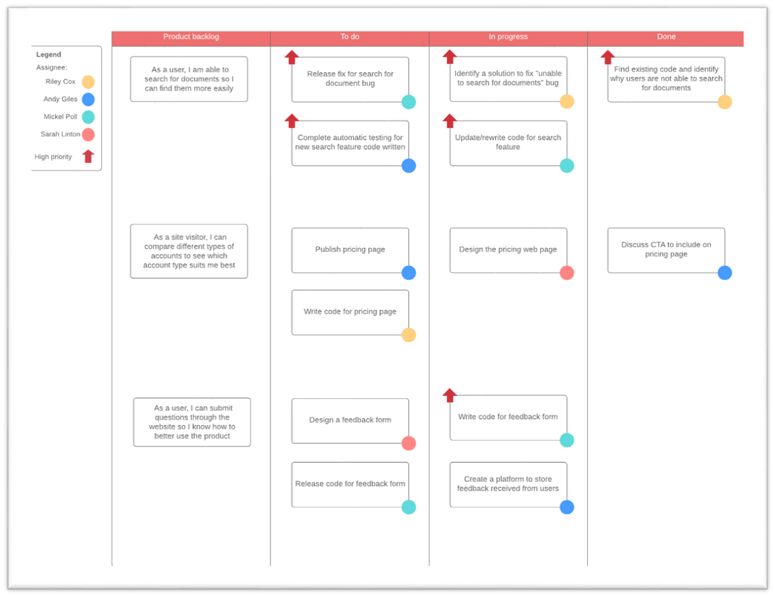
Kanban board

Slide 7
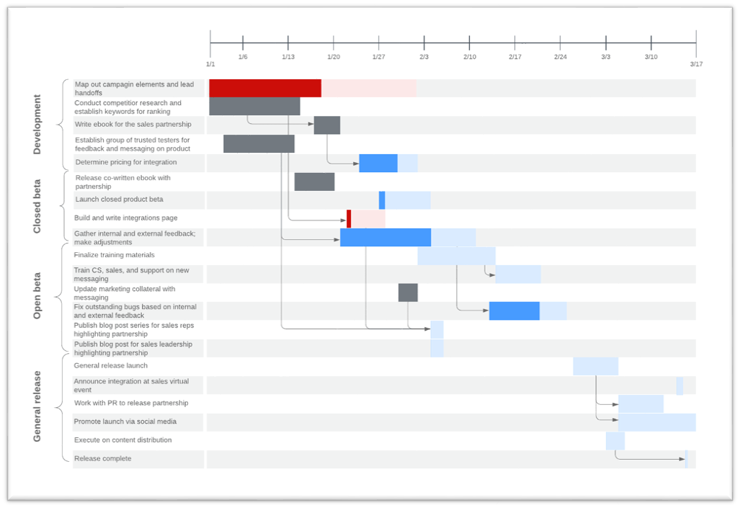
Gantt Chart

Slide 8
Ways to mitigate risks
Simplify the Necessities
Determine the goal that is required to be achieved.
Mitigate the risks of the project and how it affects people.
Get the Right Team
Individuals present all types of peril to a project, mostly due to their accessibility and services.
People with insufficient skills make the project take longer because they are slower.
Notes:
Simplify the Necessities
Determine the goal that is required to be achieved. Mitigate the risks of the project and how it affects people. Make full use of viability studies to test out the ideas before making a full obligation.
2. Get the Right Team
Individuals present all types of peril to a project, mostly due to their accessibility and services. People with insufficient skills make the project take longer because they are slower. People who aren’t available when you need them also impact your project timescales.
If likely, ringfence the resources that you require into the group. This mitigates a lot of the people-related risks. The uppermost priority projects must entice and retain the best resources in the company.

Slide 9
Cont.
Don’t try and dump all the risk on one person or group.
Mitigating your own risk by dumping it on someone else isn’t always the best approach.
Communicate and Listen
These can help you identify residual risks and strategies to engage more effectively with the stakeholders concerned.
Notes:
3. Don’t try and dump all the risk on one person or group.
Risk change is a documented and valuable risk management policy, but it has to be used with caution. Mitigating your own risk by dumping it on someone else isn’t always the best approach.
4. Communicate and Listen
There is another way that persons add risk to a project: over their actions when they are ignored as stakeholders. Communicate extensively, investigate widely, and listen to the responses you receive. These can help you identify residual risks and strategies to engage more effectively with the stakeholders concerned

Slide 10
Cont.
Assess Feasibility
Make use of viability teachings and examples to test out concepts and resolutions before you move to a complete figure.
Test Everything
Testing helps flush out problems that might bring the project to a standstill later.
Notes:
5. Assess Feasibility
Make use of viability teachings and examples to test out concepts and resolutions before you move to a complete figure. This is an easy way of not risking a plan because you can use this initial stage as a trial bed for scrutiny of ideas, methodology, and results.
6. Test Everything
Testing is often the task that gets cut. Testing is a vital part of making unquestionable that your project risk is lesser and controllable. Testing helps flush out problems that might bring the project to a standstill later. Test everything: training materials, implementation plans, and obviously software and the deliverables. Test frequently and allow longer than you expect.

Slide 11
Cont.
Have two plans
The best way to plan for the unplannable is to have alternatives. This could be:
Float in the plan
Additional incomes on reserve
Notes:
Options to break the project into segments and/or reduce scope. A Plan B isn’t somewhat that you mainly set out to want to use, but it’s there as a pillow should any of your risks appear in ways that you didn’t imagine or new risks emerge.

Slide 12
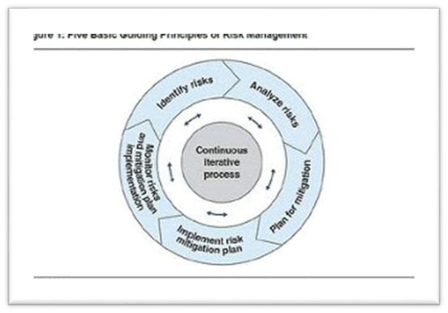
Figure 1: Five Basic Guiding Principles of Risk Management.

Slide 13
References
Aaltonen, K., & Kujala, J. (2010). A project lifecycle perspective on stakeholder influence strategies in global projects. Scandinavian journal of management, 26(4), 381-397.
Dennis, A., Wixom, B., & Tegarden, D. (2015). Systems analysis and design: An object-oriented approach with UML. John Wiley & sons.
Kendall, K. E., & Kendall, J. E. (2011). Systems analysis and design (Vol. 2013). Upper Saddle River, NJ: Pearson Prentice Hall.
Kerzner, H. (2017). Project management: a systems approach to planning, scheduling, and controlling. John Wiley & Sons.
Kumar, S., & Schmitz, S. (2011). Managing recalls in a consumer product supply chain–a root cause analysis and measures to mitigate risks. International Journal of Production Research, 49(1), 235-253.

